Slide 1
Grammar: To Be (Part II)

Slide 2
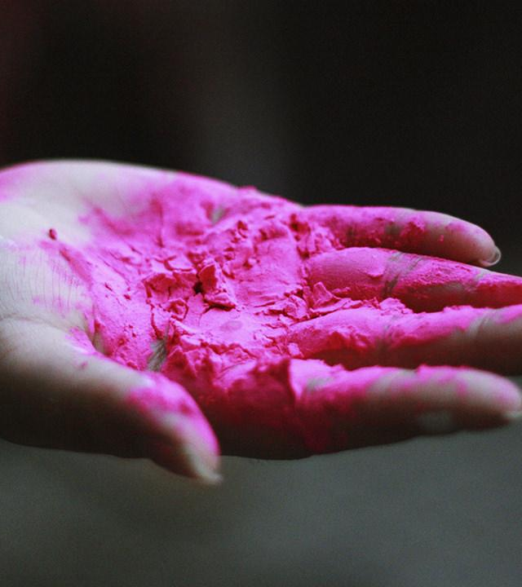
Materi dalam unit ini
Simple past tense
Setelah mempelajari dasar-dasar “to be” di unit Grammar: To Be (Part I), murid-murid akan belajar tentang bentuk lampau dari topik yang mereka telah pelajari. Di unit ini, mereka akan belajar tentang “was” dan “were” dan penggunaannya dalam percakapan sehari-hari.

Slide 3
Yesterday's the past, tomorrow's the future, but today is a gift. That's why it's called the present. -Bill Keane

Slide 4
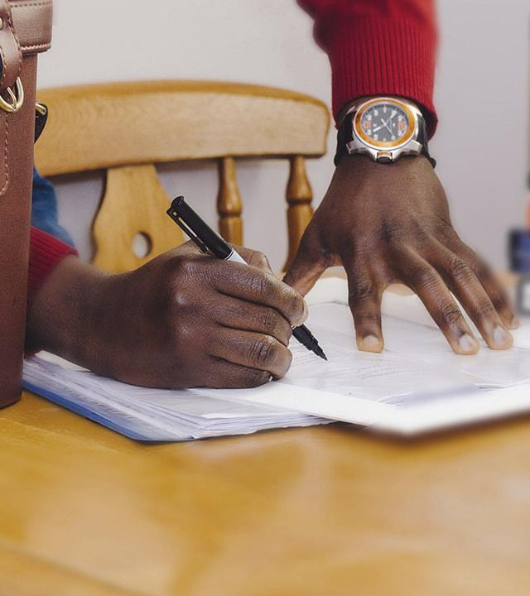
“Was” dan “Were”
“Was” dan “were” digunakan seperti “is” dan “are”. Perbedaannya adalah “was” dan “were” digunakan jika aktivitas itu sudah berlalu, dan “I” juga dipasangkan dengan “was”.
Was: I was, he was, she was, it was
I was eating
She was at home
He was tired
It was blue
Were: you were, we were, they were
You were smiling
We were at school
They were hungry

Slide 5
Conversation
Cobalah percakapan-percakapan berikut dengan teman-teman sekelas!

Slide 6
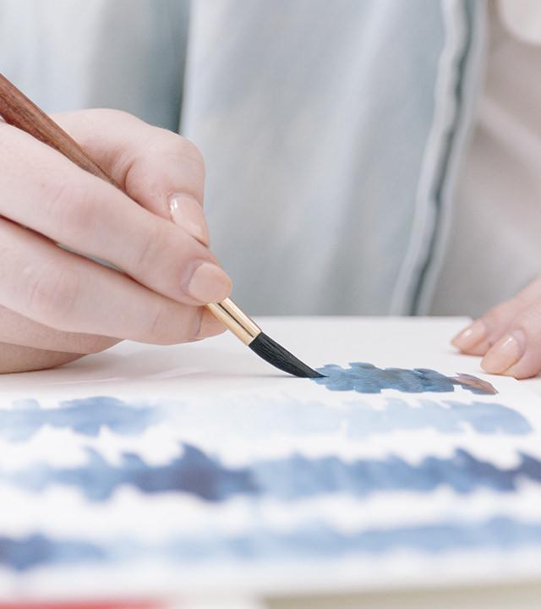
Conversation #1
Michael: Hey mark! How are you?
Mark: I’m fine, thanks! How are you?
Michael: I’m good, thanks! Did you see what Lisa was doing yesterday?
Mark: Yes, she was painting a picture. I think it’s amazing. How about you?
Michael: I saw it too, and I think it was really cool. Lisa is really talented.
Mark: I agree. I know Lisa very well. We are friends, and we learned to paint together.
Michael: That’s cool! Do you want to go see her other paintings at the exhibition?
Mark: That’s where I’m going! Do you want to come with me?
Michael: Sure! I’m so excited to see them!

Slide 7
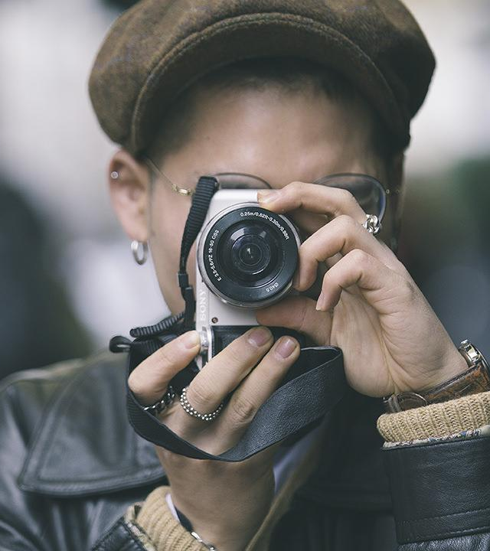
Conversation #2
Amanda: Hey Carrie! Can you please help me with my math problem?
Carrie: Of course! Here, I’ll teach you.
Amanda: Thank you so much Carrie, you are so kind!
Carrie: You are welcome! We are friends, and we have to help each other.
Amanda: That is true. I am so happy to be your friend, Carrie. I know so many other people, but they are not as caring as you.
Carrie: I am so glad that you are my friend, too, Amanda. You always make me happy.
Amanda: You are my best friend!
Carrie: You are my best friend, too!

Slide 8
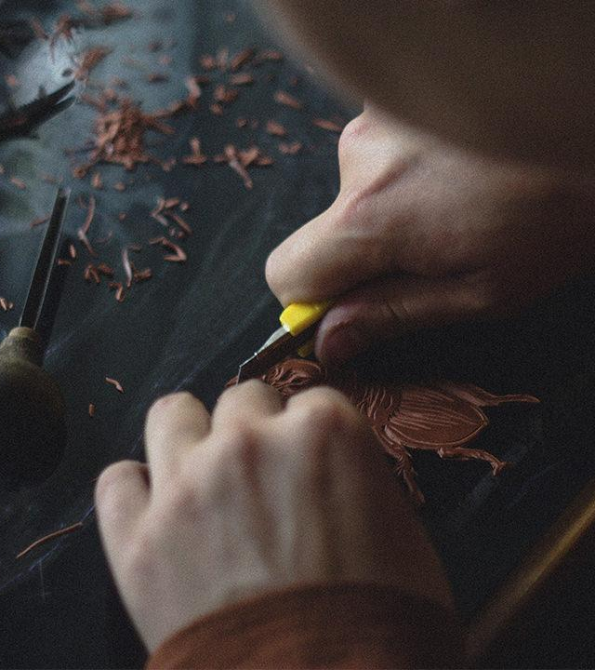
Bibliography
Thania, Sisca. “Materi Lengkap Pelajaran Bahasa Inggris SMP Kelas 7.” Jagoan Bahasa Inggris, www.jagoanbahasainggris.com/2017/04/rangkuman-materi-pelajaran-bahasa-inggris-smp-kelas-7.html.
Thania, Sisca. “Penggunaan To Be (Am, Is, Are, Was, Were) Dalam Bahasa Inggris Kelas 7 SMP.” Jagoan Bahasa Inggris, www.jagoanbahasainggris.com/2017/04/penggunaan-to-be-dalam-bahasa-inggris-kelas-7-smp.html.
This template is free to use under Creative Commons Attribution license. You can keep the Credits slide or mention SlidesCarnival and other resources used in a slide footer.

Slide 9
THANKS!
Any questions?
You can find me at
Instagram: @aannisasalsabila · email: annisa.salsabila4413@gmail.com

